Slide 1








Safe, Effective & Secure Device SDC-SDPi+FHIR Interoperability
Establishing a framework for
Trusted Interoperable Product Decoupling
Using ISO/IEEE 11073 SDC / IHE SDPi / HL7 FHIR + ISO/IEC JWG7 SES Standards
FHIR is a trademark of Health Level 7, International.
SDC is a registered trademark of OR.NET

Slide 2
Safe, Effective & Secure MDI using SDC-SDPi+FHIR
The Question
Journey from SDC to SDPi+FHIR …
Overview of SDC & SDPi for MDI
From Narratives to Plug-n-Trust
SES MDI – Proposed “Getting Started” Roadmap

Slide 3
SES SDC-SDPi Device Interoperability
Problem: Medical device interoperability (MDI) standards & Medical Technology Safety, Effectiveness & Security (SES) standards exist in parallel universes BUT products allowed for patient use must meet both the informatics interoperability technology requirements + quality, regulatory, and legal requirements.
Question: Can a framework be created to enable
Trusted Interoperable Product Decoupling
Using
ISO/IEEE 11073 SDC, IHE SDPi & HL7 FHIR Interoperability Standards
+
ISO/IEC JWG7 Safety, Effectiveness & Security Standards?
NOTE: MDI standards align with ISO/TC 215 WG2; SES with ISO/IEC JWG7

Slide 4
Acronyms
SES Safety, Effectiveness & Security – A handy way to refer to the JWG7 focus and family of standards
SDC Service-oriented Device Connectivity – Family of ISO/IEEE/CEN 11073 device interoperability standards (see TC215 WG2)
DPI Device Point-of-care Interoperability – IHE Devices sub-group designation
SDPi Service-oriented Device Point-of-care Interoperability – IHE Devices profiles using SDC & FHIR (and HL7 V2 …)
MDI Medical Device Interoperability – General label covering entire subject area
FHIR Fast Healthcare Interoperability Resources – General purpose resource-based health information exchange standards typically using RESTful architecture
QRL Quality / Regulatory / Legal stakeholder communities – For lack of a better TLA!
IHE Integrating the Healthcare Enterprise – An international standards “profiling” organization (ISO/TC 215 Liaison A)
JWG7 Joint Working Group between ISO/TC 215 & IEC/SC 62A – Home of the SES family of standards

Slide 5
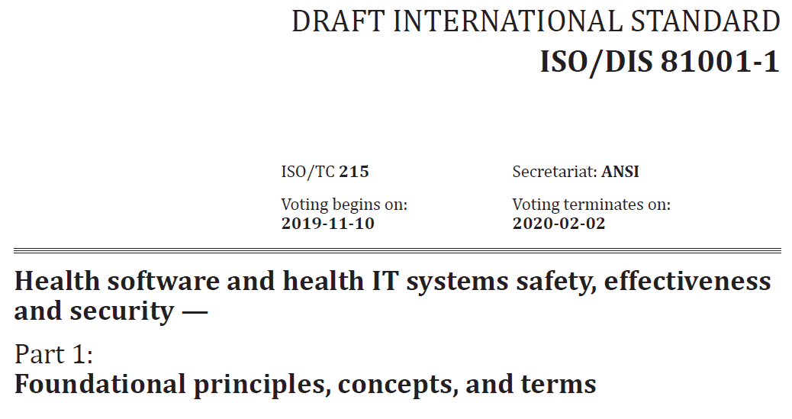
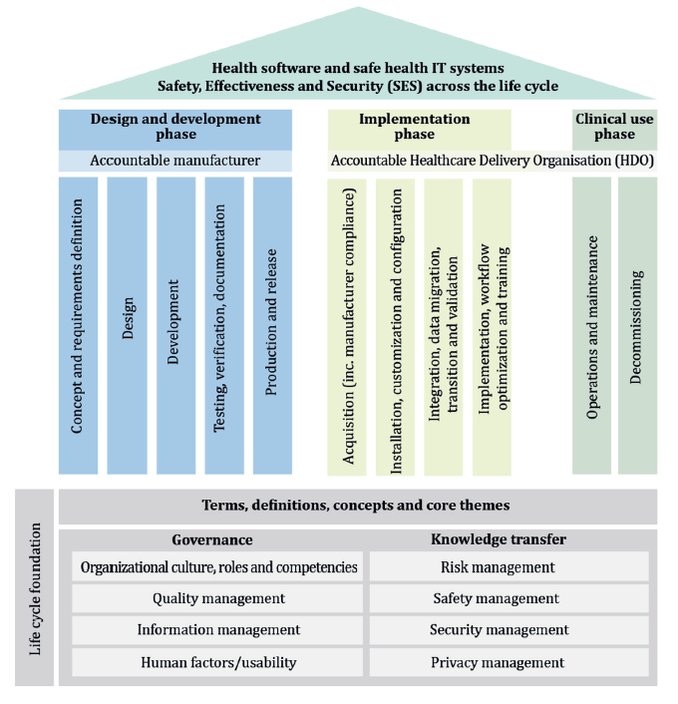
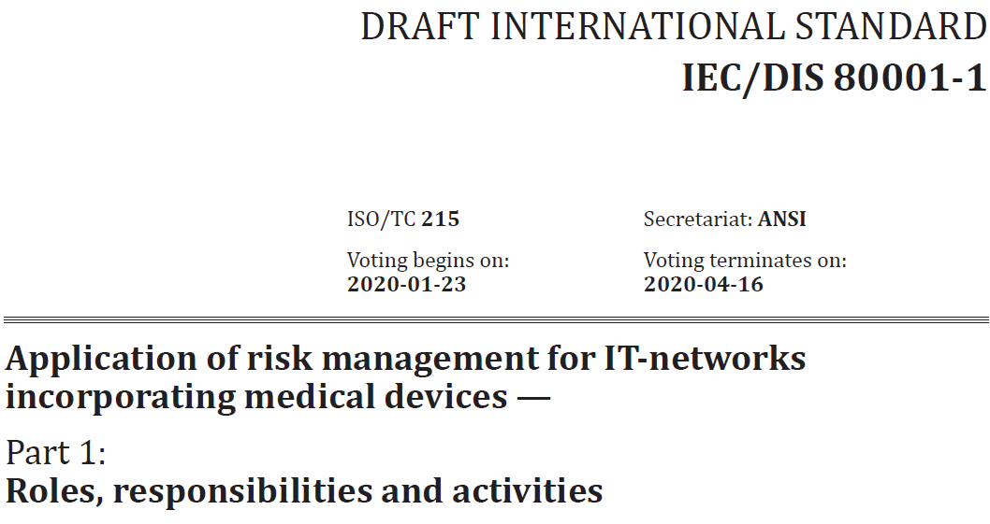
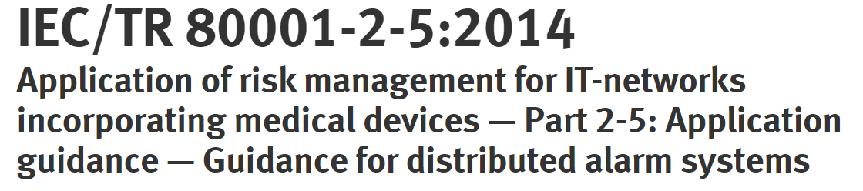
A word about “Safety, Effectiveness & Security”
As explained to the SDC-SDPi+FHIR MDI community …
Primary focus area of SES @ SDPi+FHIR white paper project
SES
MDI Trust Gap!
Two+ ISO/IEC standards & guidance documents that address SES MDI across the life cycle of health software, Health I.T. & Incorporated devices.
Diagram from 81001-1:2020 under Open Government License: see https://www.nationalarchives.gov.uk/doc/open-government-licence/version/3/

Slide 6
MDI Journey so far …
… recent history

Slide 7
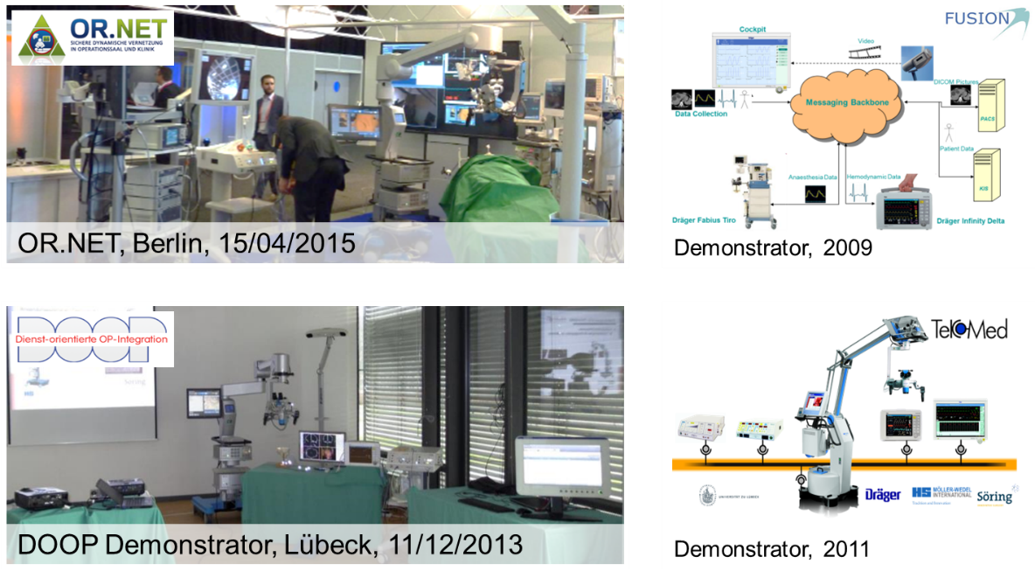
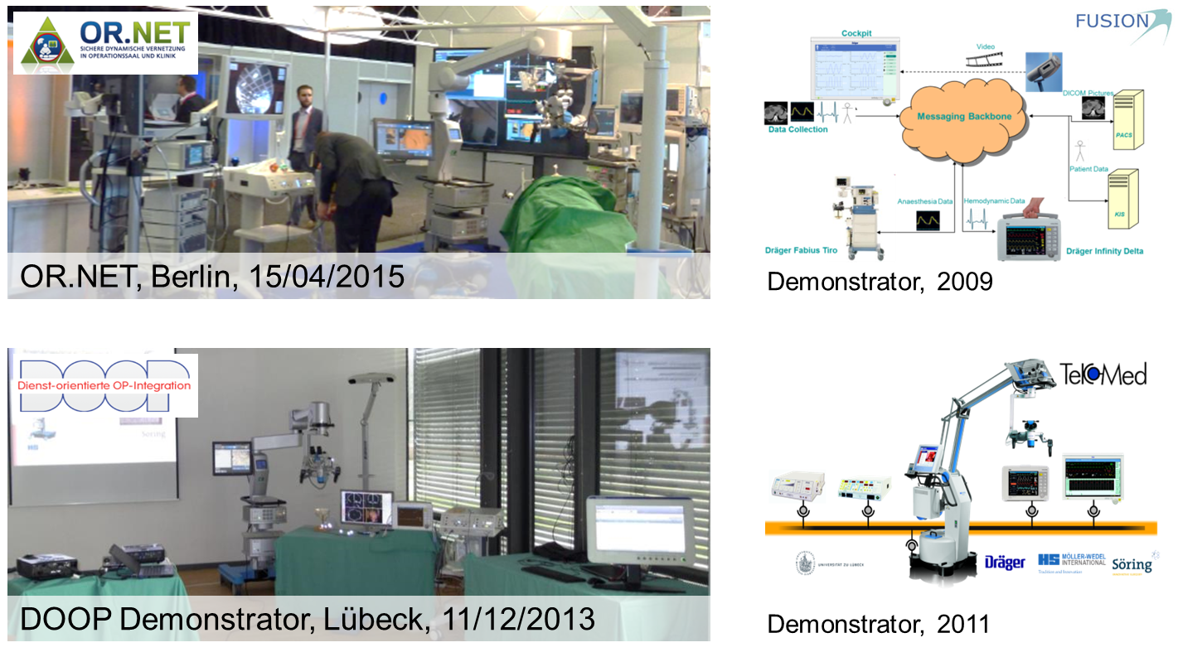


ISO/IEEE 11073 SDC – 15 Year Journey
2004
2004
2010
2011
2013
2015
2016
2017
2018
BMBF Vision SOMIT FUSION / OrthoMIT
Foundation for the idea of interoperability
TekoMed
Feasibility study to prove the SOA approach for medical devices
Dienst-Orientierte OP Integration (DOOP)
Networking project with various medical vendors to implement DPWS and demonstrate interoperability
BMBF-OR.NET
A project funded by the German Ministry of Education and Research to consolidate all medical device interoperability research activities in Germany
OR.NET Consortium
An association of different stakeholders in medical device interoperability
IEEE 11073-20702 Standard approved
Medical Devices Communication Profile for Web Services
IEEE 11073-10207 Standard approved
Domain Information and Service Model for Service-Oriented Point-of-Care Medical Device Communication
IEEE 11073-20701 Standard approved
Service Oriented Medical Device Exchange Architecture & Protocol Binding
NOTE: This roughly parallels the timelines for IHE Devices Domain & HL7 Devices WG

Slide 8
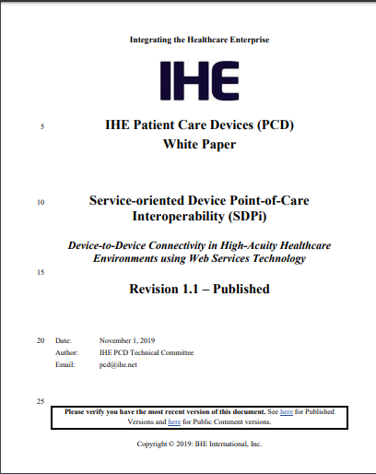
IHE SDPi – Building on the ISO/IEEE & HL7 Core
SDC@IHE 2019 Initiative laid the foundation for IHE
Service-oriented Device Point-of-Care Interoperability (SDPi)
profile family for “PRACtical” device-to-device interoperability
https://www.ihe.net/uploadedFiles/Documents/PCD/IHE_PCD_WP_SDPi_Rev1-1_Pub_2019-11-01.pdf
https://wiki.ihe.net/index.php/SDC@IHE_White_Paper

Slide 9
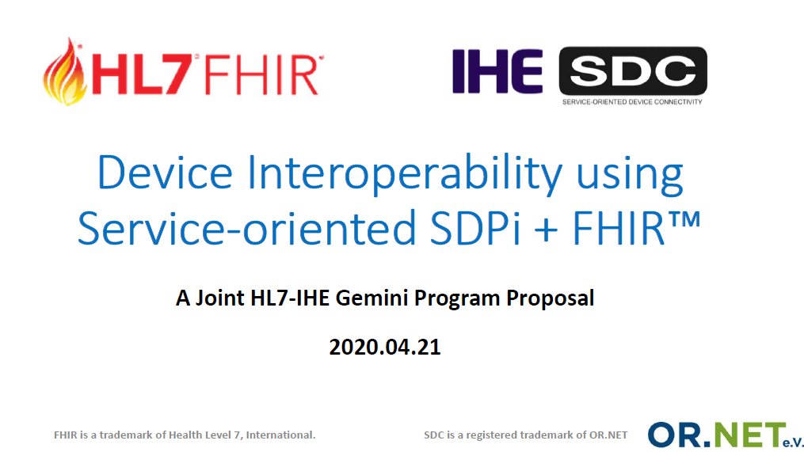
2020 Joint HL7-IHE Gemini Project
Full slide deck @ confluence.hl7.org “Device Interoperability using SDPi+FHIR” page

Slide 10
Gemini Project Deliverables & Governance
One set of cohesive, coordinated deliverables
IHE SDPi Supplement – published 2020 JUL, PAT/CAT testing Q3/4 ‘20
HL7 DoF IG supporting SDC integration & Alerting – ballot in 2020
DoF IG (proposed) for Device Information Consumers (title TBD)
Joint White Papers:
“What is a device?” - including AI/ML SAMD, across use context geographies
“Safe, Effective & Secure MDI Using SDC/SDPi + FHIR” – Quality / Regulatory / Legal Considerations
"Accelerating Safe, Effective and Secure Remote Monitoring and Mobile Health Interoperable Solutions“ – How do you know that a rapid response to address crisis (e.g., pandemic) challenges is safe enough, effective enough, and secure enough to allow for implementation & use?
Governance based on HL7 or IHE project home organization processes

Slide 11
A bit more on …
SDC-SDPi+FHIR
… for MDI

Slide 12








Enterprise
Gateway
Alarm Delegation Services
EMR
LAB
PACS
Point-of-Care
Patient Monitoring
Ventilation
Central Station
Bedside information hub
Infusion systems
imaging systems
Standards for device-to-device interoperability at Point-of-Care ?

Slide 13
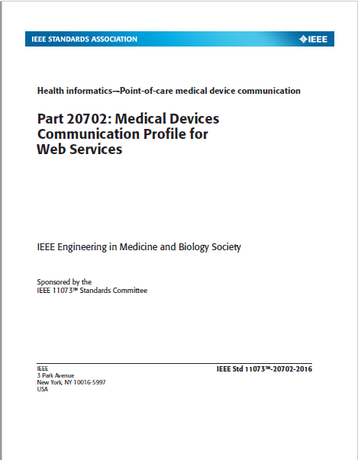
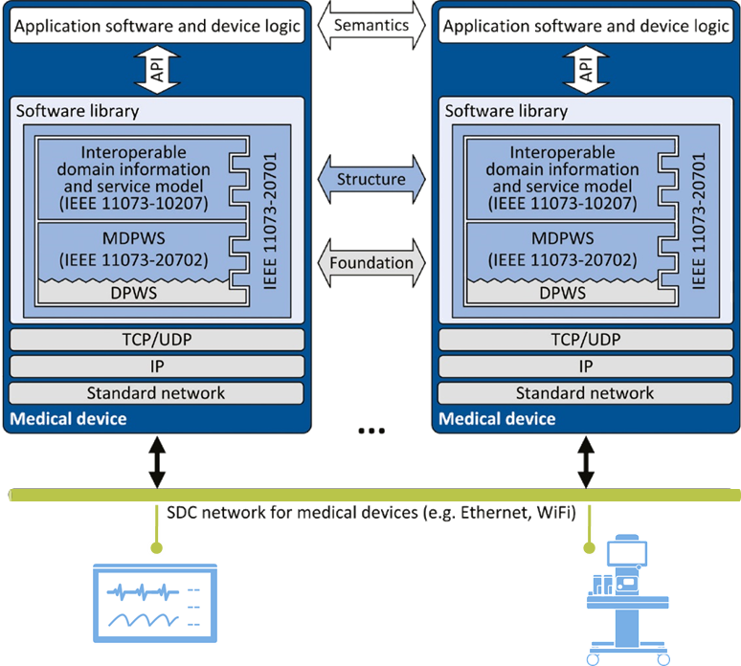
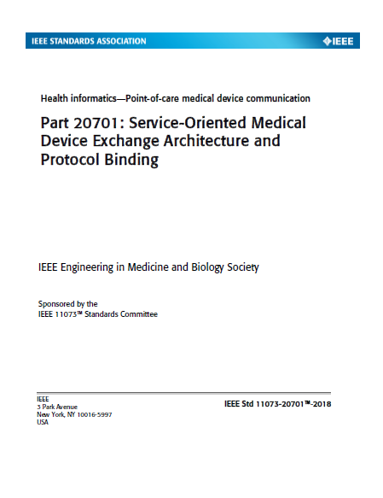
What is SDC?
Service-oriented Device Connectivity
A family of international standards for interoperable exchange of real-time information between medical devices and external systems in dynamic IP networks

Slide 14
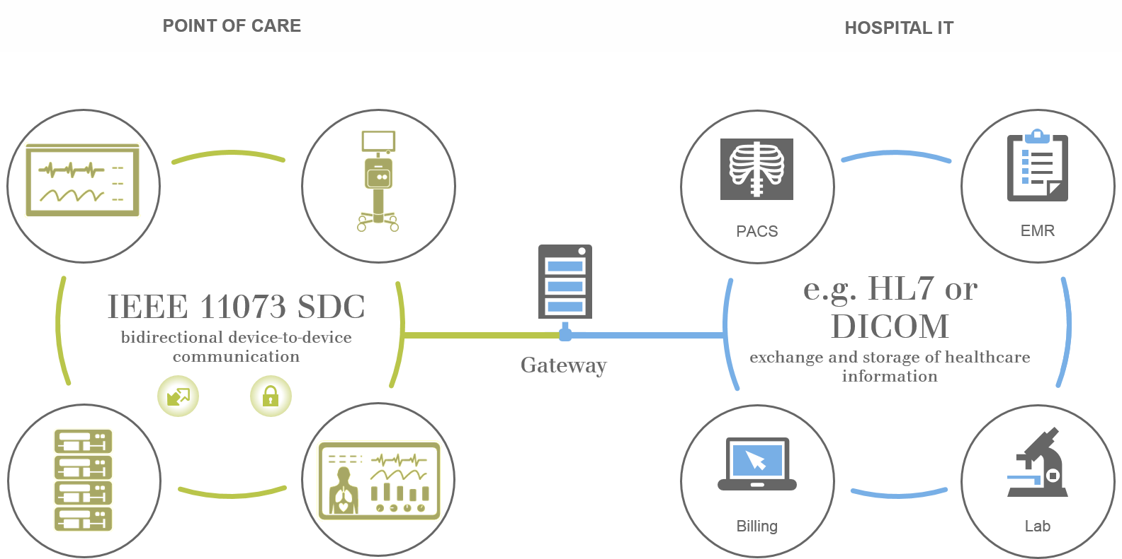
SDC Basics …
SDC Point-of-Care Context
HIT “Enterprise” Context
Device-to-Device
Plug-and-Play for
Reporting / Alerting & Controlling
(PRACtical Interoperability)

Slide 15
IEEE 11073 SDC Standards “Cathedral”
Device Specializations
Participant Key
Purposes
Nomenclature
Core Connectivity
Standards

Slide 16
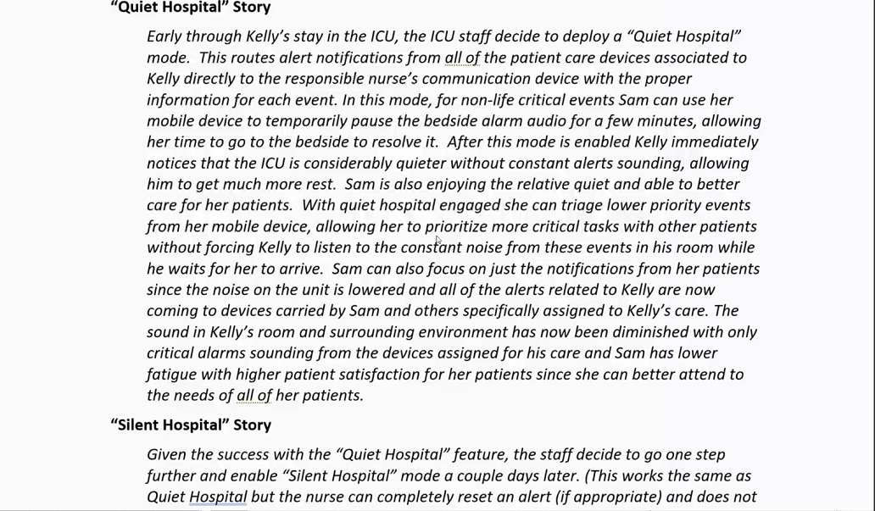
Example: Quiet Hospital / Silent Hospital Narratives
NOTE: Current version of these narrative documents are available on the Gemini SDPi+FHIR Quiet Hospital Confluence pages.

Slide 17
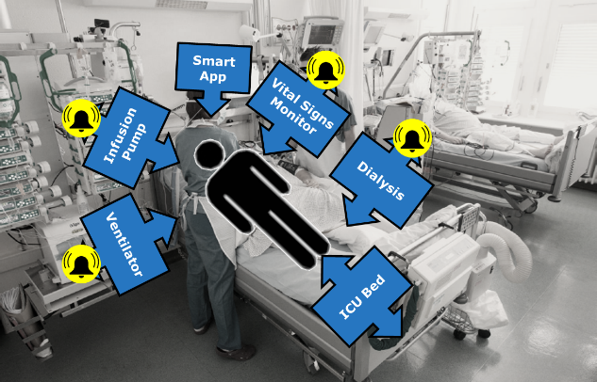
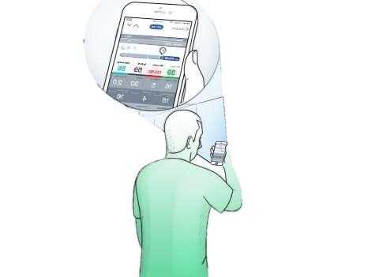


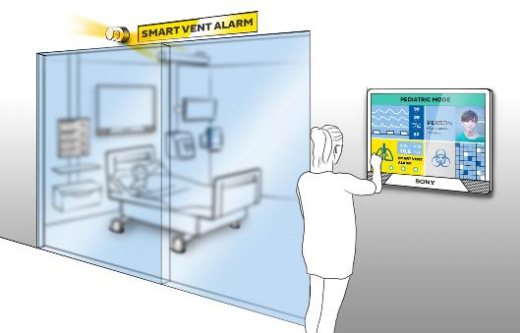

SDC & Quiet Hospital/Silent ICU @ HIMSS’20 …
SILENT ICU BY ALARM SIGNAL DELEGATION
Today
Tomorrow
Z
Z
Z
ok!
Reduction of alarms
road to
1
alarming device per patient
~ 80 - 95 % clinically irrelevant
up to 40 min. to alarm confirmation
50 % are not noticed
Alarm Distribution
~ 40 different sounds in one ICU

Slide 18
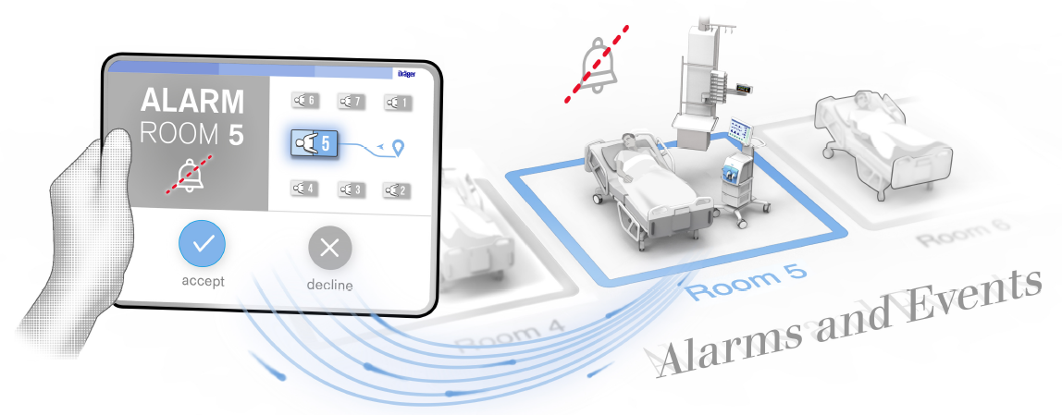
SDC & Quiet Hospital/Silent ICU @ HIMSS’20 …
SILENT ICU BY ALARM SIGNAL DELEGATION - Requirements
“Delegation” – Safely enabling one system to annunciate alerts on the behalf of another system
The alarm producer has to make all information available that are necessary for the remote alarm notifiers, like alert condition presence, alert manifestation, etc. Interoperability and semantical interpretability have to be ensured.
The system has to be suitable for multiple alarm producers and several remote alarm notifying devices.
The alarm producer has to be able to determine whether other devices are ready to generate the alarm notification.
The alarm producer has to be able to observe that the alert is generated correctly.
Some more information: „A Safe and Interoperable Distributed Alarm Notification System for PoC Medical Devices using IEEE 11073 SDC”, Kasparick et al.

Slide 19
Alert Signal Delegation Use Case
From IEEE 11073-10207 (BICEPS)
ALERT SIGNAL DELEGATION is the capability of a POC MEDICAL DEVICE to let another PARTICIPANT generate a POC MEDICAL DEVICE’s ALERT SIGNAL as primary ALERT SIGNAL in order to remotely indicate the presence of an ALERT CONDITION on the POC MEDICAL DEVICE.
a POC MEDICAL DEVICE delegates its ALERT SIGNAL generation to another PARTICPANT, e.g., to facilitate a silent workplace
Delegable & Fallback Alert Signals

Slide 20
Alert Signal Distribution Combining IEEE 11073 SDC & IHE PCD ACM
IEEE 11073 SDC
IHE PCD ACM
Alert
Provider
Patient Monitoring
PCD-04/05
PCD-06/07
Ventilation
Alert
Provider
Gateway
Alert
Manager
Alert Communicator
Alert
Consumer
Alert
Reporter
SDPi Alerting
(SDPi-A)

Slide 21


SDC – Security is a Core Capability
SDC Communication
Ventilator V1
Vendor: xyz Corp
Roles:
Metric Provider
Operation Provider
Certified by:
Vitals Dashboard D1
Vendor: ABC Corp
Roles:
Metric Consumer
Operation Consumer
Certified by:
Standard based encryption of communication: TLS 1.2+
Each endpoint has a certificate.
Authentication at both endpoints
No communication if no trust chain can be established
Certificates are used to secure communication
Authorization and Authentication
Certificates carry roles of participants
Each device can decide if remote control is OK based on certificate roles and certifying organization
SDC = Enables Trusted Interoperable Product Decoupling
(Stretch goal: Computable IFU discoverable at Plug-n-Trust network connection & configuration … just sayin’ …)

Slide 22
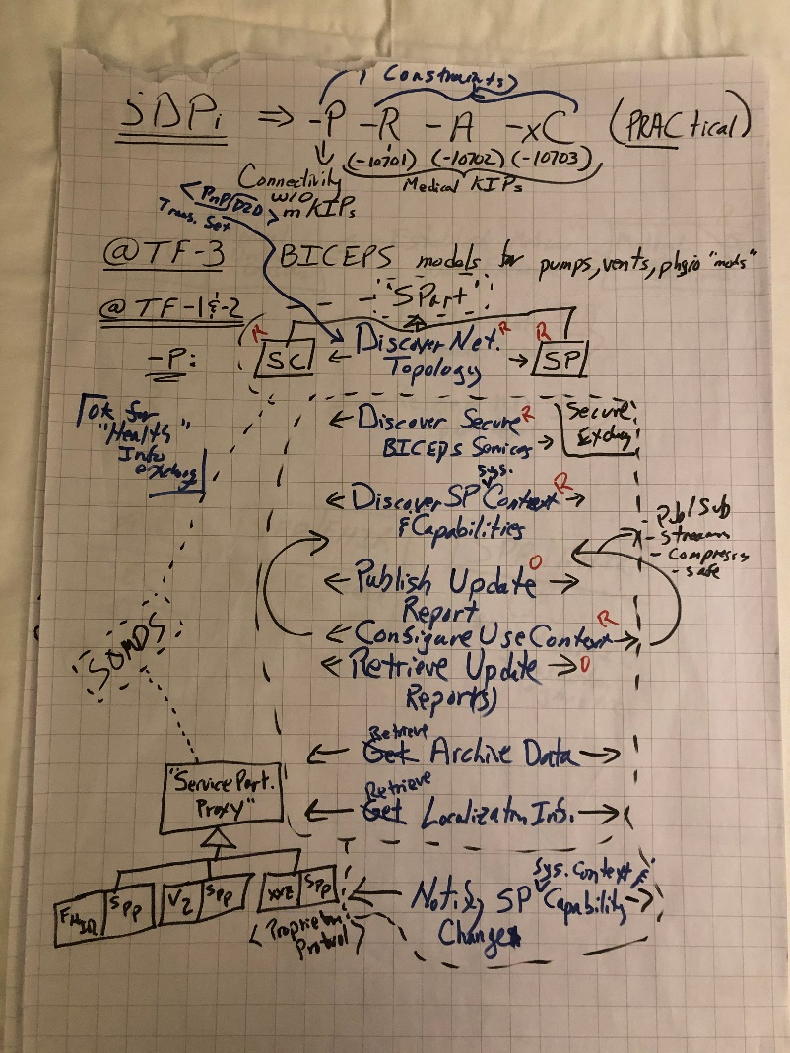
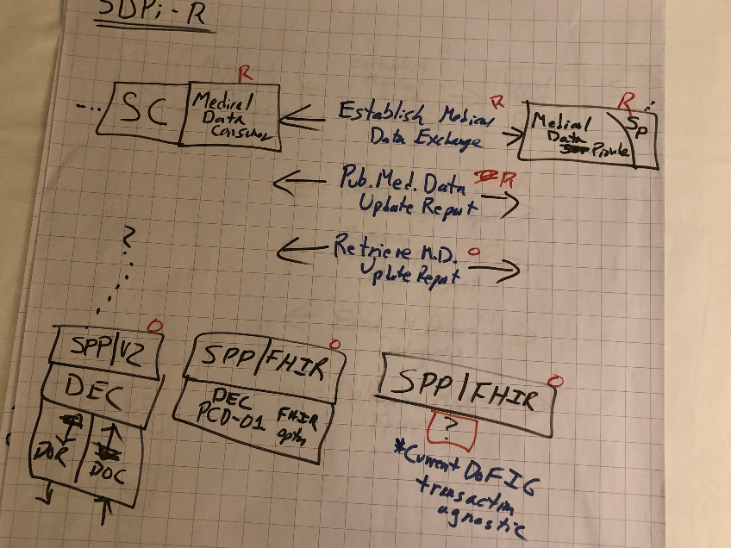
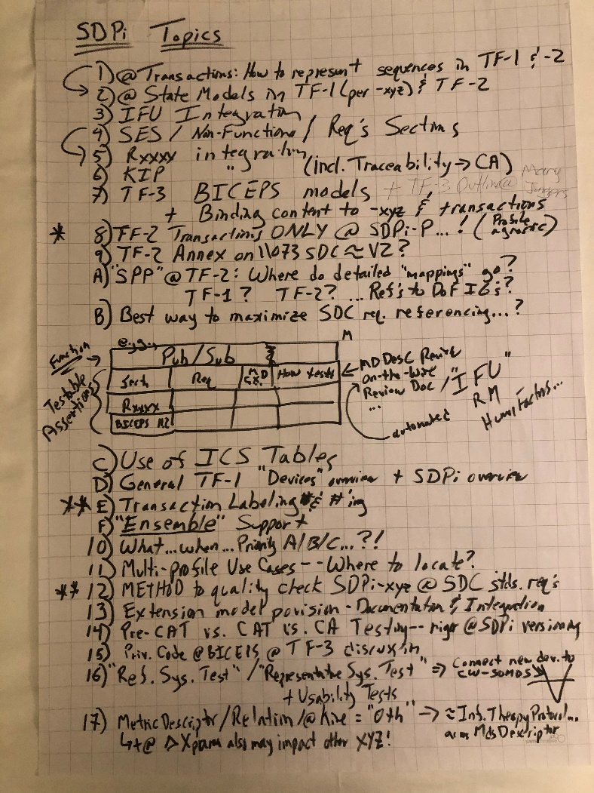
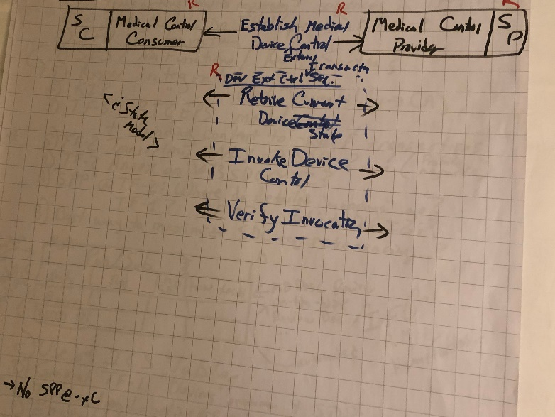
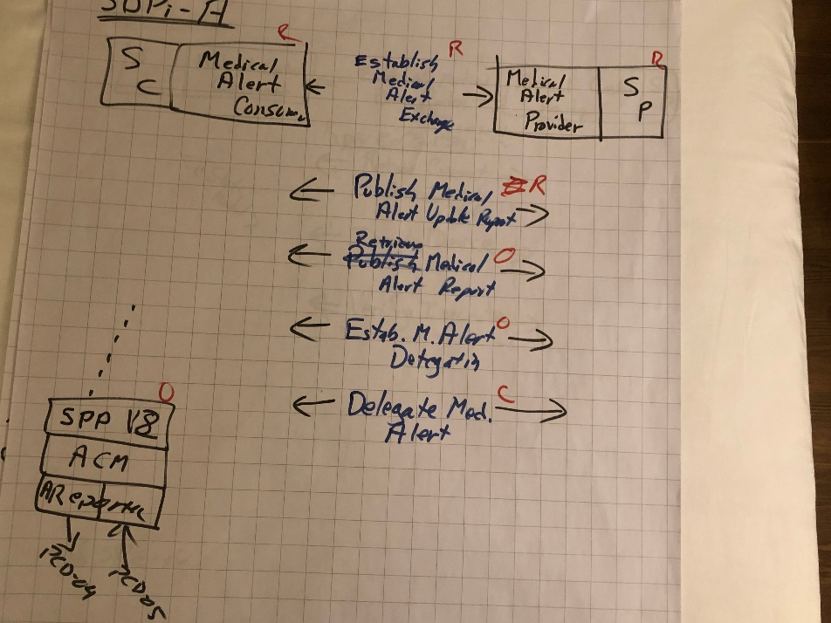
SDPi+FHIR Technical Concept
IHE Devices domain Technical Framework Approach Established
IHE SDPi Supplement w/ 4 profiles under development – in parallel
Will include content for TF-1 -2 & -3
IHE Connectathon testing planned for 2020
The Amsterdam Sessions 2019.11

Slide 23
IHE SDPi – Building on the ISO/IEEE & HL7 Core
IHE SDPi Profiles for “PRACtical” Device Interoperability
SDPi Plug-and-Trust Connectivity
(SDPi-P)
SDPi Reporting
(SDPi-R)
SDPi Alerting
(SDPi-A)
SDPi external Control
(SDPi-xC)
“medical” interoperability purpose
HL7 FHIR
PoCD IG
DEC
ACM
SDC PKP Standards
IHE “Gateway” Actors Defined
FHIR Base Resources
HL7 V2 Messaging
SDC Core Standards

Slide 24
SDC PKP’s – Pathway to Trust at the Interface
BICEPS / Dev Specializations
SDC SES Design Approach
Establish Key Purposes of Interoperability from MDS to interface:
Connectivity
Reporting
Alerting
External Control
Integrate “testable assertions” into each standard (”Rxxxx”)
Bind Rxxxx from layer to layer, incl. risks from one layer mapped into RCMs in the next
Address both Functional & Non-functional (RM) Aspects
Per-device System Function Contribution defined
MDPWS/WS-*

Slide 25
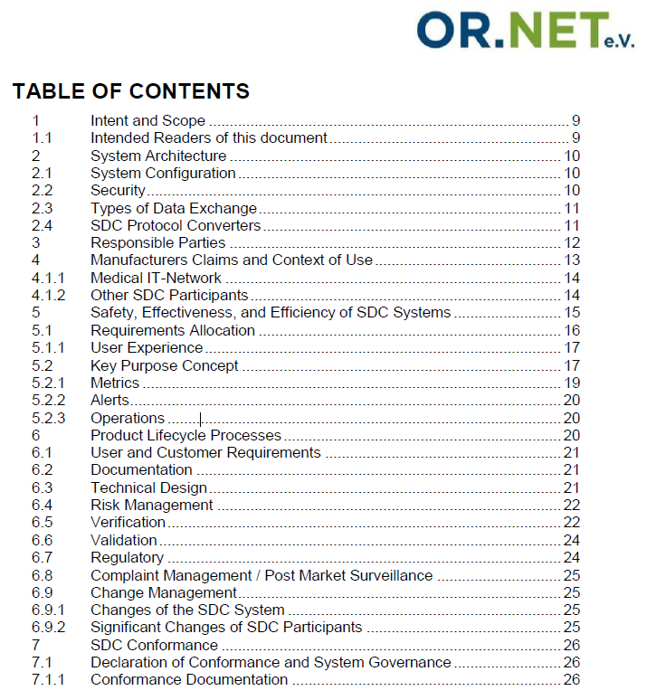
SDC Conformance Principles
OR.NET* white paper lays foundation for traceability from PKPs to Conformity Assessment (CA) and certified safe-effective-secure (SES) interoperable medical device system components.
IEEE 11073 -10700 Base PKP standard includes annex with summary of Conformance Principles
* Germany-based non-profit academic / industry group

Slide 26
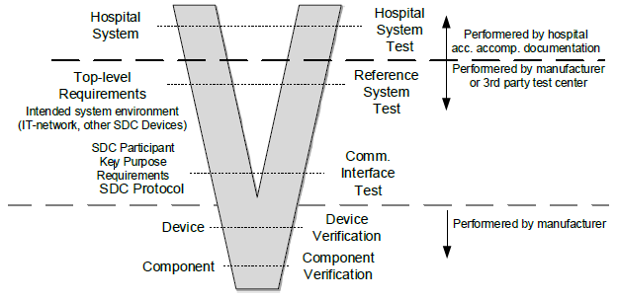
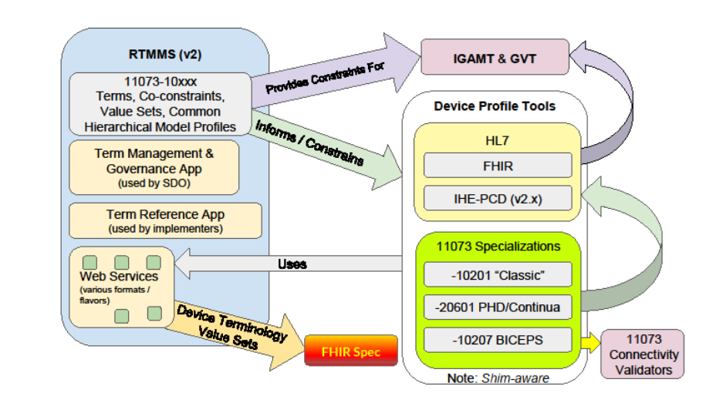
SES Plug-n-Trust Requires Rigorous Testing
Leverage the established Device Interoperability tooling …
Objective: Leverage IHE Test & Tooling to establish an SDC-enabled interoperable medical technology ecosystem where certified test reports can be directly included in regulatory submissions
NIST Device Tools

Slide 27
For more general SDC-SDPi+FHIR Info …
Primary source: confluence.hl7.org “SDPi+FHIR Community”
Schlichting / Unity presentation @ https://bit.ly/Record-MDI
HIMSS’20 Klotz/Cooper SDC MDI digital session (to be posted)
IHE DEV SDPi White Paper –
Wealth of info including Bibliography with useful
links to papers and presentations and open source
Implementations, etc.
https://www.ihe.net/uploadedFiles/Documents/PCD/IHE_PCD_WP_SDPi_Rev1-1_Pub_2019-11-01.pdf

Slide 28
Connecting the dots from
… inspiring narratives
… to Plug-n-Trust!

Slide 29
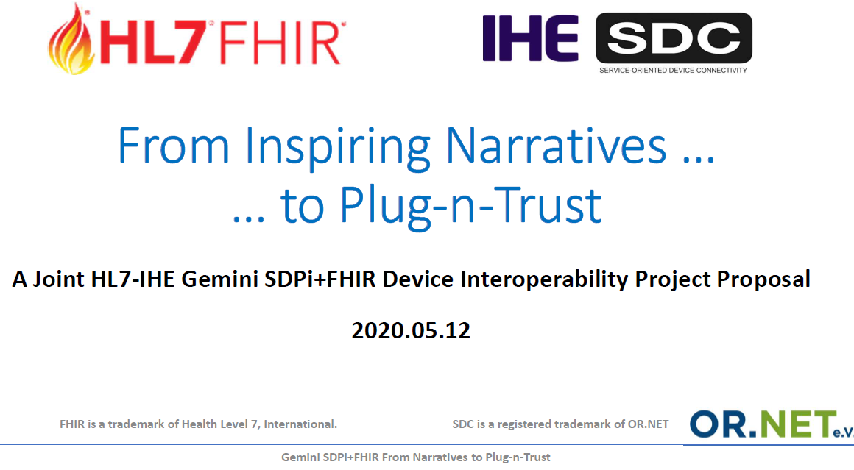
Full slide deck @ confluence.hl7.org “SDPi+FHIR Tools“ page

Slide 30
From Inspiring Narratives to Plug-n-Trust
Establishing a framework strategy for …
Capturing detailed requirements from use narratives in a clear and computable manner;
Enabling mapping & traceability & simulation through each technology and quality specification layer;
Testing V&V conformity assessment at the interoperable component and system of interoperable products level
… an ecosystem of trusted, safe, effective & secure, plug-and-play device & health software solutions using
SDC-SDPi + FHIR

Slide 31
Journey starts @ Inspiring Narratives
Gemini SES MDI Project:
Functional Endoscopic Sinus Surgery / Operating Room Integration
Quiet Hospital / Silent ICU
JHU/APL MDIRA/ICE for Military & Disaster Casualty Care
Preeclampsia During Pregnancy – Home to Clinic to Hospital
(in process) “Loopers” Type 1 Diabetes – Person-crafted Closed-Loop Control
https://wiki.ihe.net/index.php/SDC@IHE_White_Paper
Gemini SES MDI Use Case home pages @
HL7 Confluence “Device Interoperability using SDPi+FHIR”/SDPi+FHIR Use Cases

Slide 32
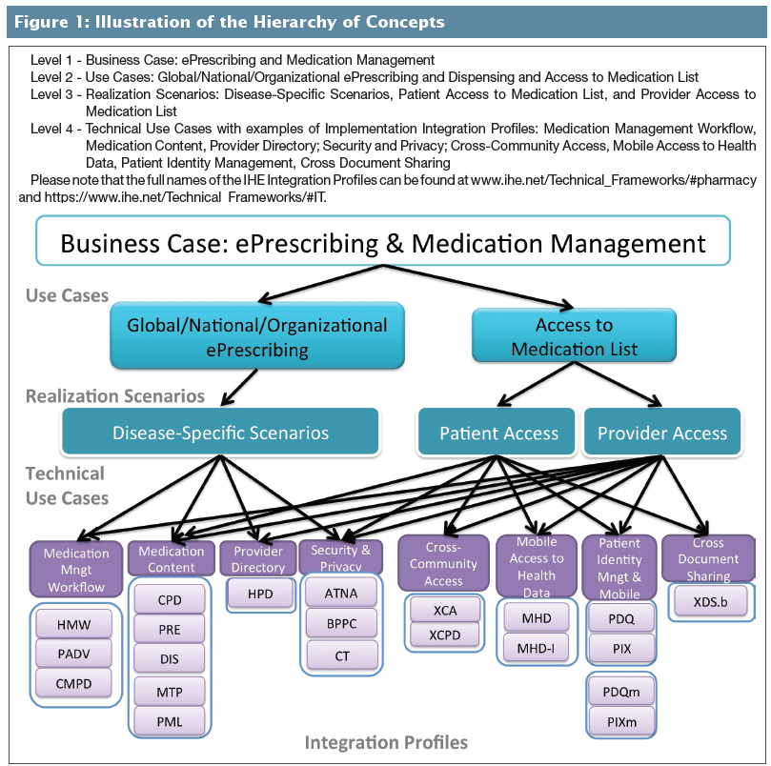
IHE Use Case Analysis – Hierarchy of Concepts
Source: Journal of AHIMA, 2017 July – October series, “Understanding User Needs for Interoperability: Standards for Use Cases in eHealth”

Slide 33
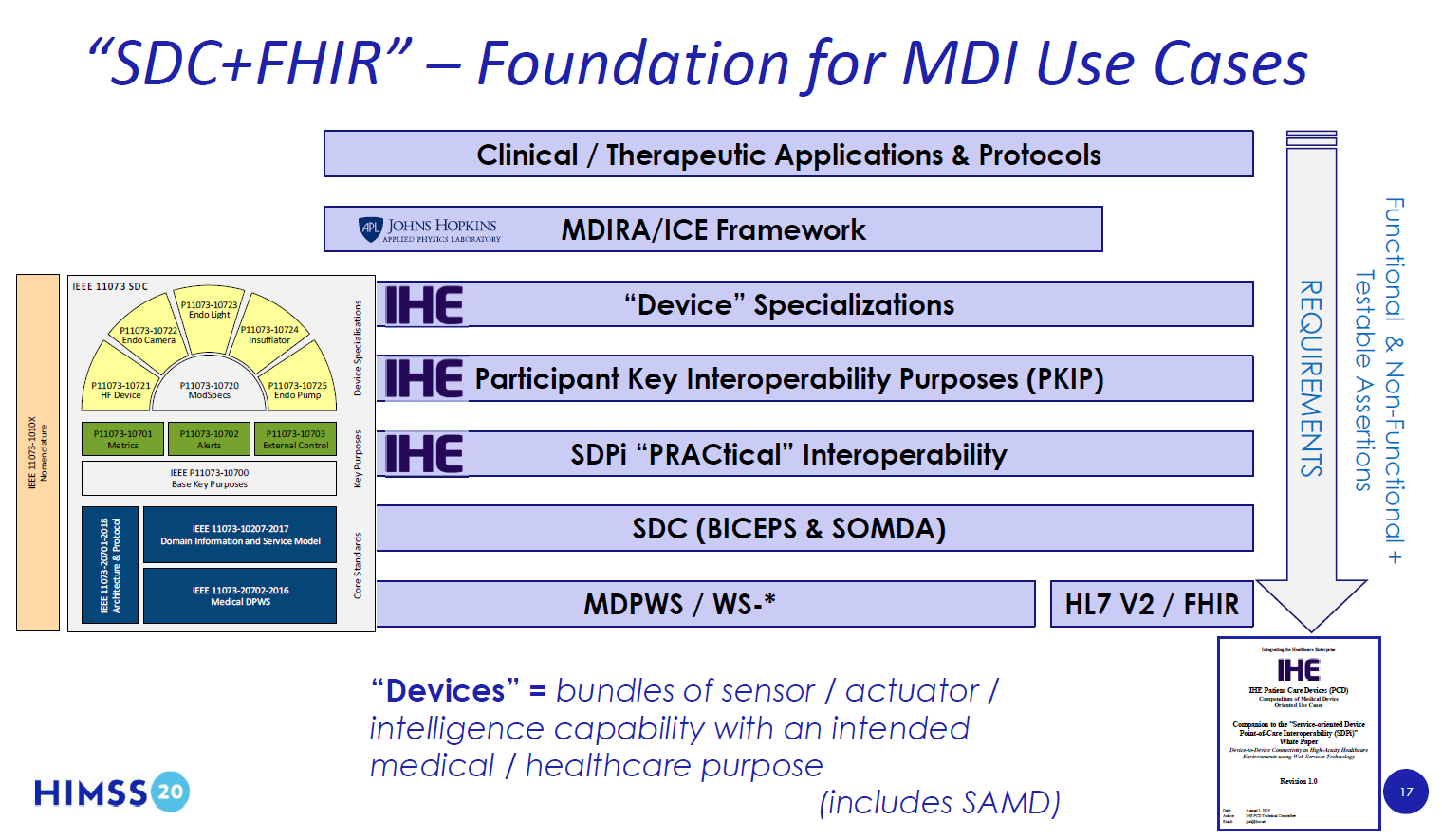
“SDPi+FHIR” – Introduced @ HIMSS’20 …

Slide 34
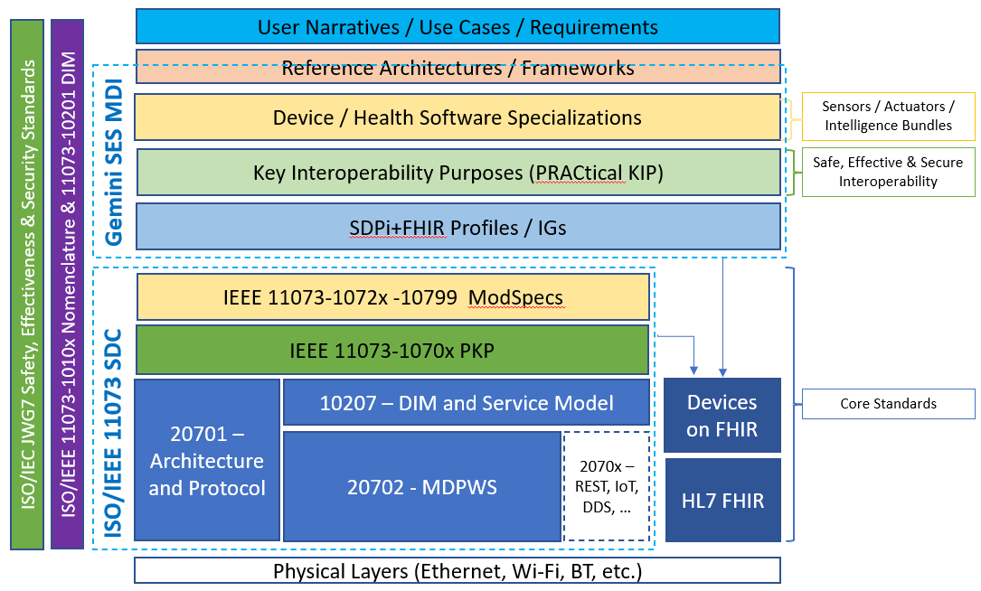
Expanding the Requirements-to-Interfaces Model
ISO/IEEE 11073 SDC –
“Cathedral” Model
Multiple Standards / Specifications
Multiple Organizations / SDOs
Multiple Projects / Initiatives
Note: model is not perfect … but very useful!

Slide 35
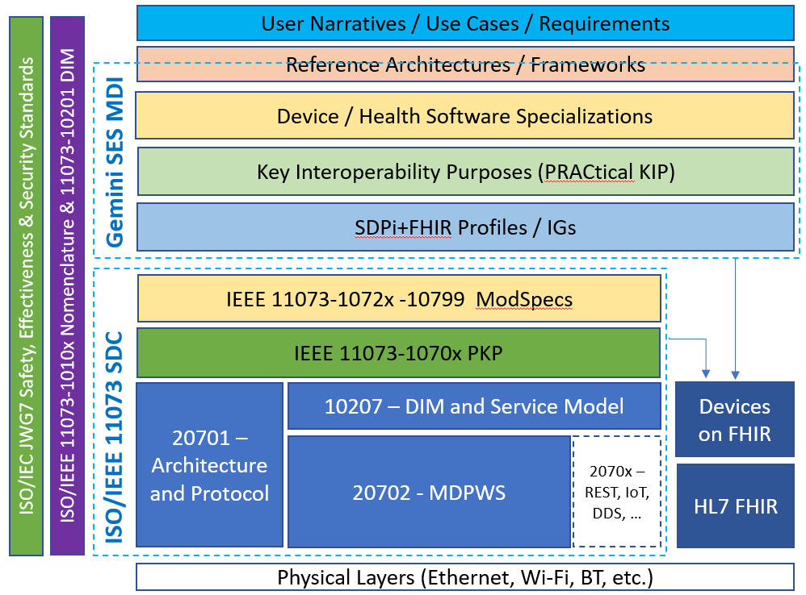



Charting the course from narratives to interfaces
Traceability from Narrative to
Plug-n-Trust Interface!
Each “layer” specifies requirements to be mapped to the next
Each “layer” adds its own set of requirements
Requirements align with safety, effectiveness & security (SES)
NOTE: Null layers allowed but generally required to achieve the SES Plug-n-Trust objective.
/ Ecosystem
Comprehensive System Function Contribution (SFC) Plug-n-Trust Interfaces

Slide 36
Charting the course from narratives to interfaces
The Challenge …
Establish computable traceability from top to bottom (plug-n-trust) interface
Automate mapping and testability
Scale from simple to complex
Layer-specific and layer-to-layer (mapped) requirements representation
Lower the bar for specification creation, adoption, implementation and use
Maximize use of off-the-shelf open, “free”, widely adopted and used tooling
Ensure integration with corporate enterprise-grade tooling (including DOORS, Enterprise Architect, MagicDraw, etc.)
Support V-model CA and 3rd party (17025) “test houses”
…
“Mapping” remains the hardest nut to crack in this list of challenges. Especially across multiple standards, organizations and projects!

Slide 37
Capturing Computable Use Narrative Requirements
User Narratives / Use Cases / Requirements
Question: How to capture computable, testable requirements starting with user narratives?
Narrative “User Story” Text
Objective: Real-world user detailed descriptions of what is to be supported; narrative may conform to a general template / questions.
Use Cases / Scenarios Analysis
Objective: Analyze the “business case” narratives into use cases, realization scenarios & technical use cases (using standardized templates)
Gherkin / Cucumber Representation
Objective: Standard computable use case / scenario representation. Basis for test tooling & transformation to ReqIF specifications.
ReqIF (Requirements Interchange Format) Representation
Objective: Formal requirements modeling (including “relations” mapping) that forms the basis for bi-directional traceability + testing & tooling
Note: See ReqIF background information below.

Slide 38
Examples for tracing Narrative to Plug-n-Trust
Exemplar considerations from Quiet Hospital Narratives:
Identify (4) scenario-based requirements that can be verified during CA test
Include (4) alert priorities: Event + High/Medium/Low Alarms
Trace through the (4) KIP standards
Include both Physiological & Technical Alarms
Include at least (2) modalities + modality-specific alarms (e.g., AIL)
Include DIS, DAS & C-DAS support, scaling from simple to complex
Include both Quiet & Silent Hospital requirements
Include both SDC and FHIR endpoints
Note: SDC alert delegation integrates all four interoperability purposes & SDPi profiles

Slide 39
What if …
We mashed together the
MDI & SES
Communities & Standards!?!

Slide 40


A Framework for Trusted Interoperable Product Decoupling
Addressing the SES MDI Ecosystem “Trust Gap” …
SES
MDI Trust Gap!
Diagram from 81001-1:2020 under Open Government License: see https://www.nationalarchives.gov.uk/doc/open-government-licence/version/3/

Slide 41
SES MDI – Roadmap Proposal
Develop an IHE-HL7 Gemini SES MDI framework concept white paper (underway):
See confluence.hl7.org “SDPi+FHIR Paper - SES MDI” page
“Safe, Effective & Secure MDI Using SDC/SDPi + FHIR” (working title)
Intent is to think through what would be involved in establishing a standards-based framework for Trusted Interoperable Product Decoupling (as identified in the preceding slides)
See below for potential content and discussion topics
White paper intended to be jointly balloted and published by IHE & HL7
Participation is open to all experts – no organizational membership or $$$ required
Add 2020-June TC/215 WG2 & JWG7 TR PWI for the above white paper
Anticipate Gemini SDPi+FHIR white paper to be submitted to JWG7 via IHE Liaison “fasttrack” process mid-2020
White paper will include recommendations to JWG7 for standards coordination and development
Invite WG2 & JWG7 members and parent committee experts to participate in the white paper
Consider recommendations to WG2 & JWG7 later in 2020; may include a proposal for an SES MDI international standard and guidance (e.g., 81001-7-x) leveraging content in the white paper

Slide 42
SES MDI using SDC-SDPi+FHIR - Content
White Paper content may include:
Subtitle: Strategy for enabling an ecosystem of trusted interoperable decoupled products
Consider the Plug-n-Trust “pathway” through the SES Temple + MDI Layers
Identify and discuss the application of standards to be considered …
Including coordination with and normative references to/from related standards …
ISO/IEEE 11073 SDC, HL7 FHIR, JWG7 81001-1, 80001-1/-2X, 82304-X, 62304,…)
In the parent committees (e.g., 60601-2-x & 11073 family)
Other ISO/IEC committees (e.g., JTC1, ISO TC210)
SES MDI computable assurance case concept, aligned with related JWG7 work
Address the use of OMG ReqIF to represent both MDI and SES requirements
Consider how to integrate ReqIF specifications + Plug-n-Trust SFC CA results into computable assurance cases
Strategy and roadmap recommendations for addressing standards gaps, implementation and test tooling, and multi-stakeholder collaboration & coordination, etc., necessary to address the …
SES MDI Trust Gap!

Slide 43
Additional
Information

Slide 44
OMG Requirements Interchange Format (ReqIF) “Mapping”
Background

Slide 45
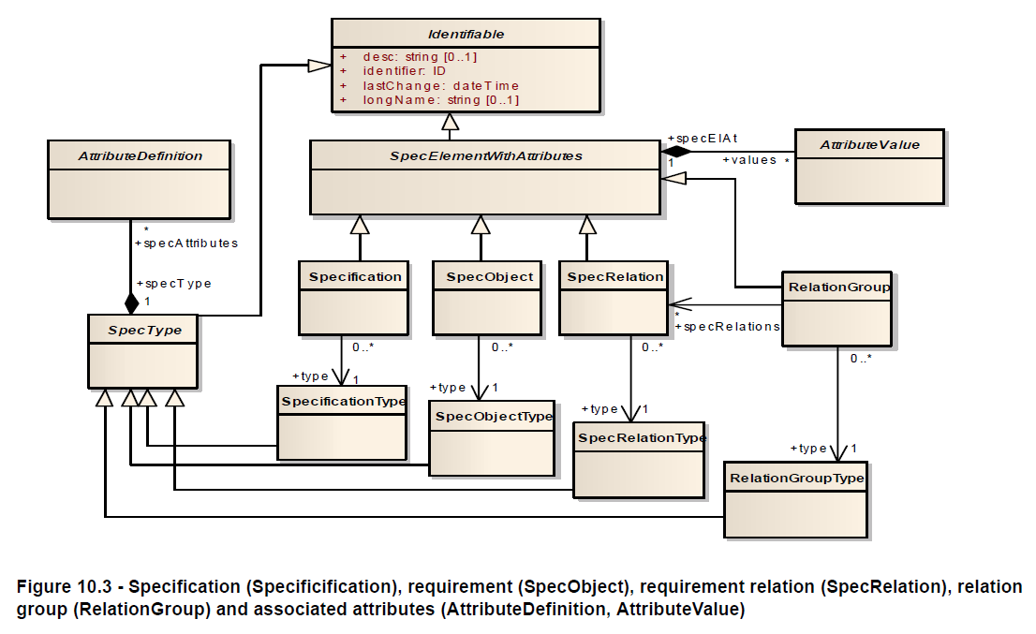
OMG ReqIF: Base Model

Slide 46
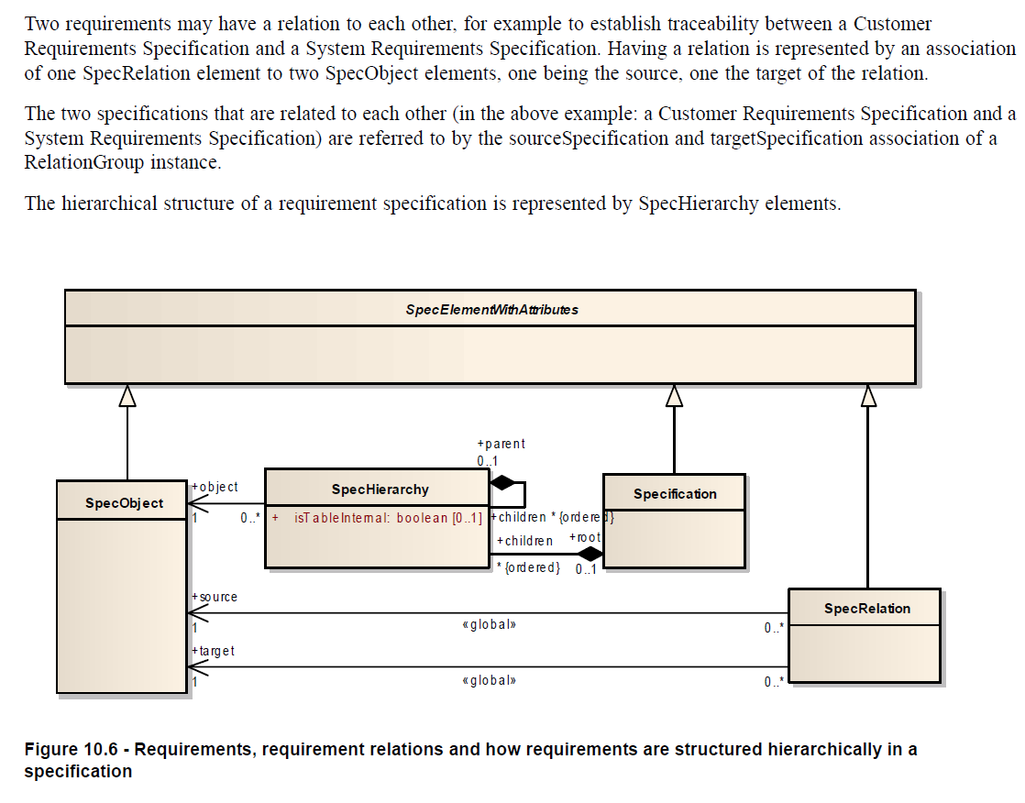
ReqIF: Requirement Hierarchies & Relationships
“mapping” between
Source & Target Requirements

